Slide 1

Data Mining Project Presentation

Slide 2
Executive Summary
After performing an analysis of the US census data we believe that strategies to encourage completion of a bachelor degrees and encourage professional careers are the most beneficial to grow income outcomes in the US.
One's education level is a strong indicator of higher income levels
Ones career field is shown to be statistically significant in terms of their future earning power
Married US residents are shown to have a higher earning potential then their non married peers

Slide 3
Data Overview
The data we used came from a US Census Bureau database from 1994.
It includes the attributes showing below:
Age
Workclass
Fnlwgt (the number of people in the population that each record represents)
Education
Education-num
Marital-status
Occupation
Relationship
Race
Sex
Capital-gain
Capital-loss
Hours-per-week
Native-country
We're aiming for a household with an annual income of $50,000 or more as our direct marketing campaign's target.

Slide 4
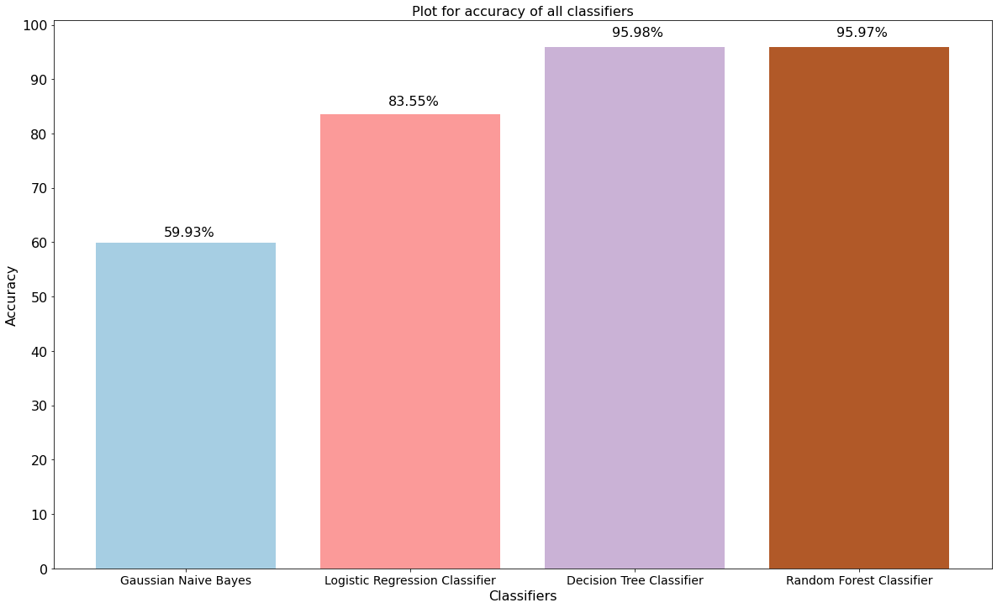
Model Summary
Tested Models: Naive Bayes , Logistic Regression , Decision Tree, Random Forest
We chose Random Forest Classifier as the best performing algorithm to predict the income exceeding 50K
One of the main metrics used to decide the optimal model was Accuracy rate.
Random forest’s Model’s Accuracy score is 96%(approximately)

Slide 5
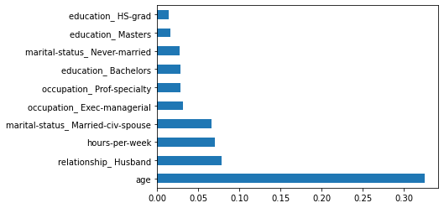
Insights from Model
According to our model, Exec management and Prof services, Marital status civ spouse,education:bachelors, education:,, hours per week, age are the top most important features to predict income over 50K.

Slide 6
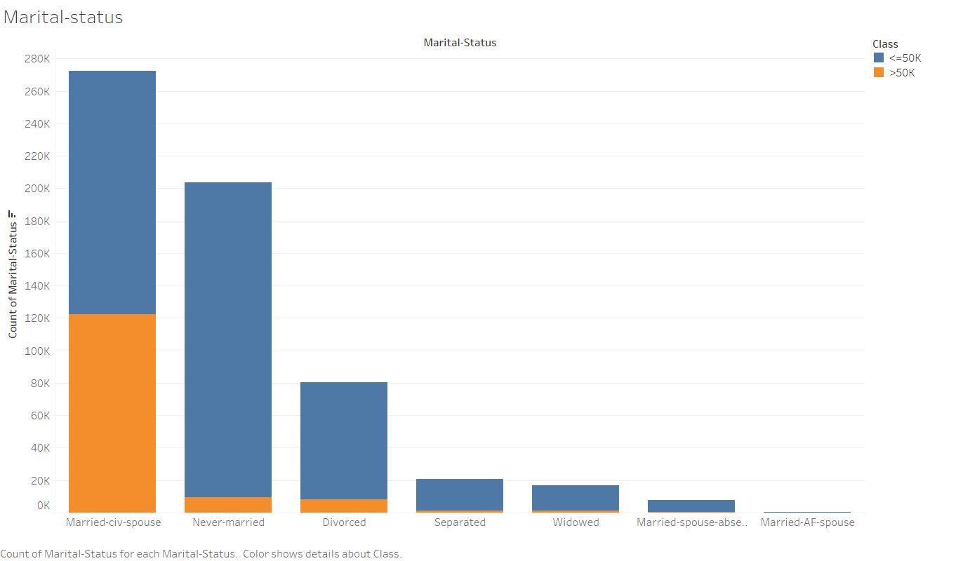
Effect of Marital Status on Income
According to the analysis of the US Census, marital status is one of the most important factors that influences someone's earning potential.
More specifically, of the six marital statuses included in our model, the group "Married-civ-spouse" has the largest percentage of those earning more than $50,000 as well as largest absolute numbers, comparing to other groups.
Both the feature importances and the stacked bar chart on the right confirm our findings.
The percentage of those earning more than $50,000 in each of the other groups is much lower which is also reflected in our model.

Slide 7
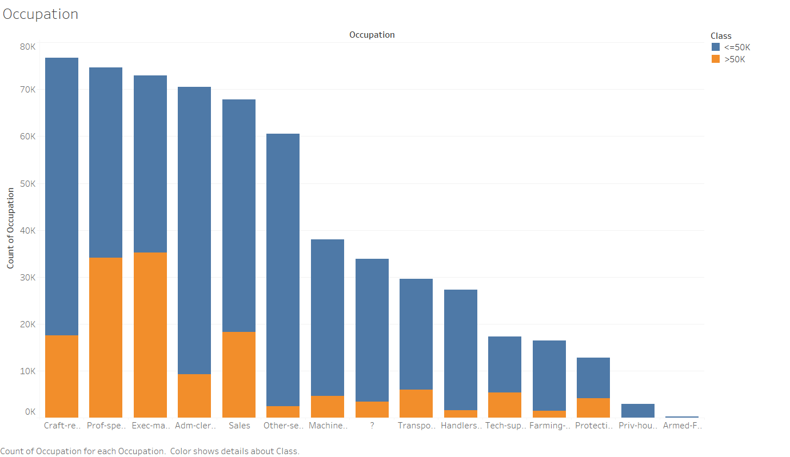
Effect of Occupation on Income
Based off of our model one of the strongest indicators for someone making over $50,000 in the US is their job title
More specifically the most important job titles for predicting one's income level is if they are an Executive/in Management or work in a job field under Professional Speciality (lawyer, accountant, engineer, Professor, etc)
This is supported by the raw count of US residents as both Exec/Management and Professional Speciality rank 1 and 2 for income over $50,000
Both Executive/Management and Professional Speciality also share the distinction of occupations that typically require a higher level of education

Slide 8
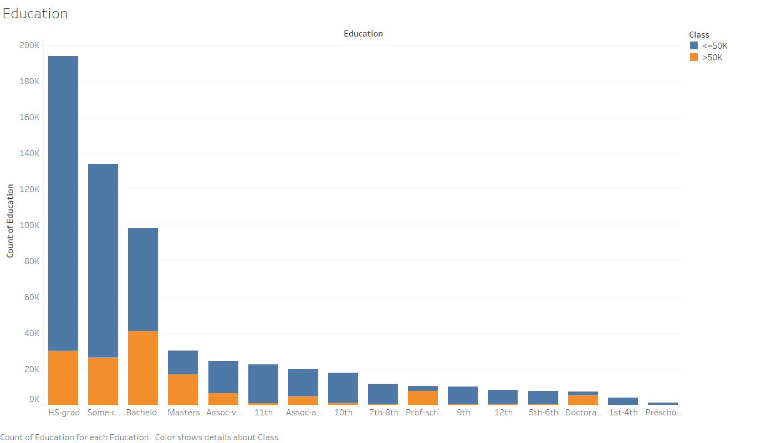
Effect of Education on Income
One's level of education was shown to be an indicator of income level in the US
Specifically our model showed that the completion of a Bachelor's degree and to a lesser extent a masters degree were predictors for income over $50,000.
This is displayed in the accompanying graph that shows those with Bachelor degrees with the largest share of income >$50,000
While High school and some college have the next largest shares of income >$50,000 our model shows that they are not indicators of a higher income.

Slide 9
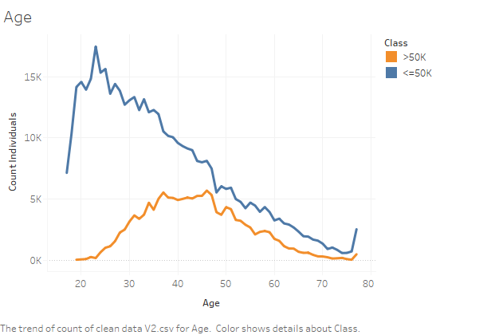
Age and Income
Based on our model, we able to say Age has a significant impact on one's income.
From the line charts, both income group <= $50,000 and income group > $50,000 have an increasing trend at first and then goes down.
This shows that as people age there is a positive correlation with age and an increase in income..
It can be observed that for income group <= $50k, main age group is between 25 years old to 35 years old; and for income group > $50k, main age group is between 35 years old to 50 years old.
It also makes sense that once someone reaches retirement age that their income drops as they are only living off of retirement benefits, which is shown in our graph
Notes:
I will be talking about our findings and insights in numeric variables

Slide 10
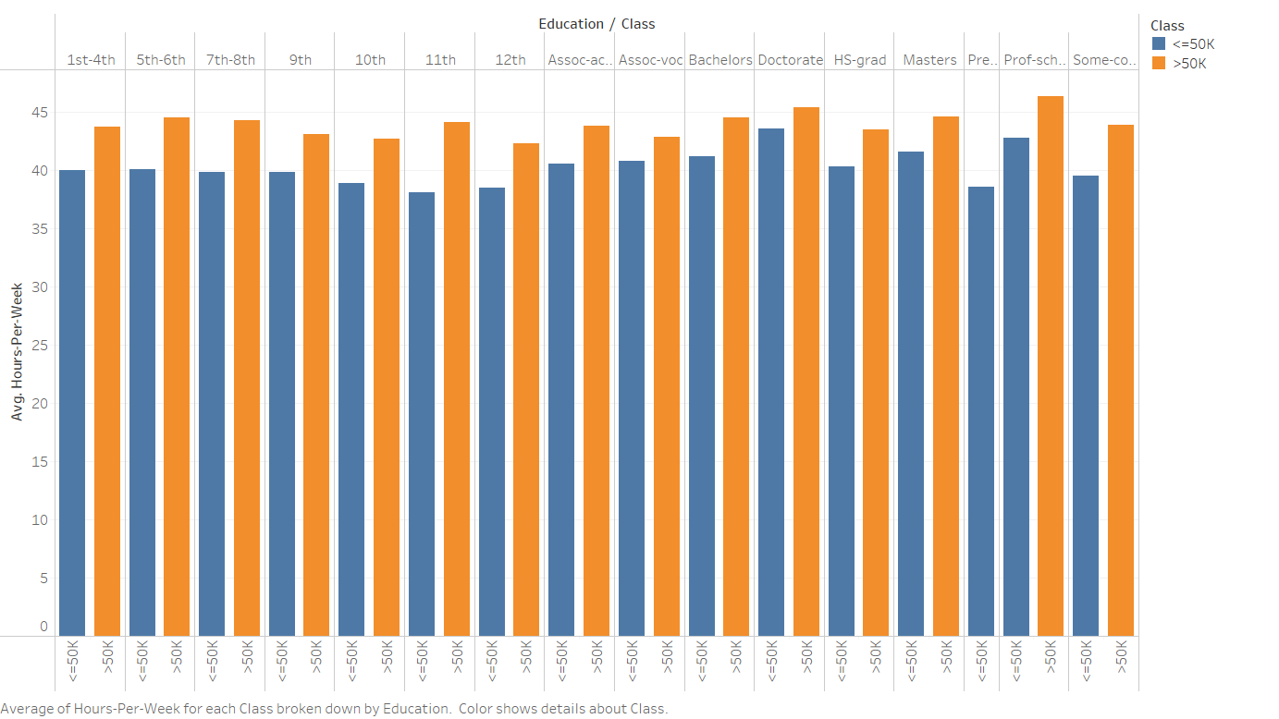
Further Insights from Numerical Variables
We were able to see connections between the variables education level, income group and average hours per week. While not overly surprising we can see that those who work longer hours per week on average have a higher frequency of income over $50,000
We have also noticed that the number of hours worked per week is not impacted by one's education level.
Longer hours worked has a higher frequency of income over $50,000 across all levels of education
Notes:
We found working hours per week is an important variable as well

Slide 11
Recommendations
In summary we have found that the greatest indicator of a US resident having an income over $50,000 is one’s occupation, level of education, marital status, and age. With this in mind we have come up with the following recommendations to increase the likelihood of US residents making over $50,000
Make an investment to expose high school students to careers in Professional Specialities through elective classes, and talks with local professionals in these career fields.
The US should not only focus on preparing high school students for college, but also further invest resources to help students complete their Bachelor's degrees instead of taking a gap or dropping out all together. This would help to increase the number of residents with a Bachelors degree and thus increase the likelihood that someone would make over $50,000.
Marriage is also shown to be a strong indicator for an income greater than $50,000. Because of this we recommend that further investment is made for research to dive into what parts of marriage specifically drive higher incomes.

Slide 12
Thank you

Slide 13
Appendix

Slide 14
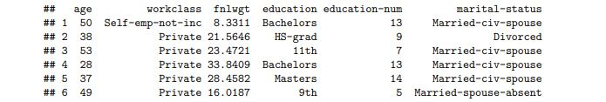
Observations Methodology
In this model there was a total of 6,179,295,876 observation. However from this total observation count we took a sample of 601,547 observations across the 14 variables. We did this by taking a random sample of 1/10,000 of the total observations, which allowed us to clean the data in r and build our models in python.
Below is a snapshot of the dataset output from r:

Slide 15
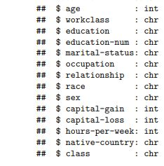
Numerical vs. Categorical Variables
The data set from the US Census included a total of 14 different variables. We split these into either categorical or numeric variables. This is shown in the table below:
When it came to deciding which variables would be considered categorical, most were straightforward however education-num (years of education) looked like a possible numeric variables. But after looking further into each number we determined that education-num was actually serving as a marker for each category in the education variable. We confirmed this by checking the amount of discrete data points

Slide 16
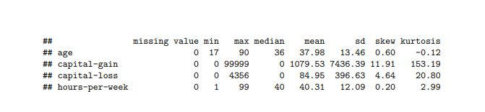
Statistics for Numeric Variables
We found that the numeric variables are age, capital-gain, capital-loss , and hours per week. Below is our table showing missing values, min, max, median, mean, standard deviation, skewness, and kurtosis:

Slide 17
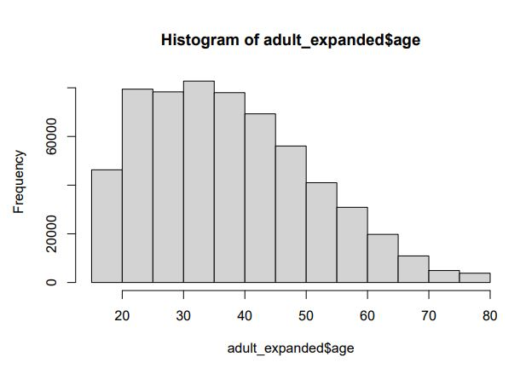
Diagrams for Numeric Variables - Age (½)

Slide 18
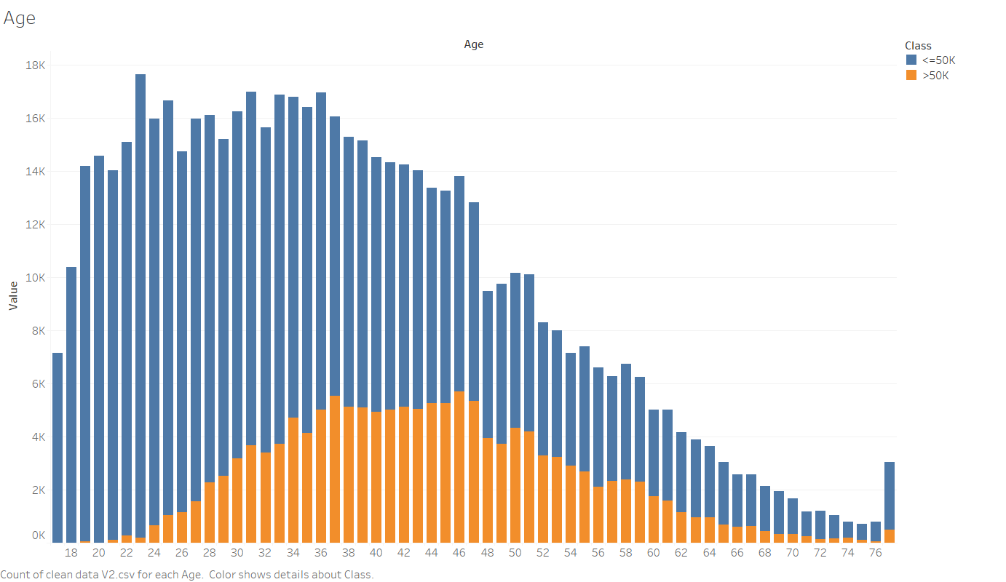
Diagrams for Numeric Variables - Age (2/2)

Slide 19
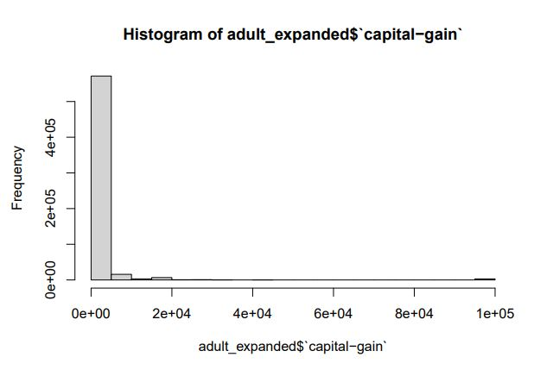
Diagrams for Numeric Variables
Capital Gains:

Slide 20
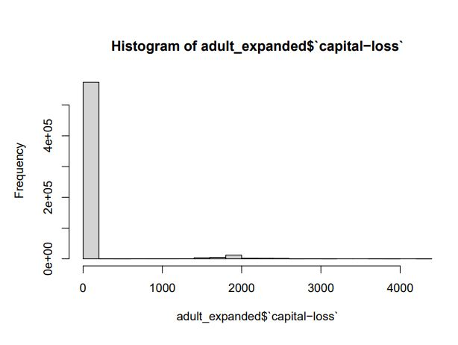
Diagrams for Numeric Variables
Capital Loss:

Slide 21
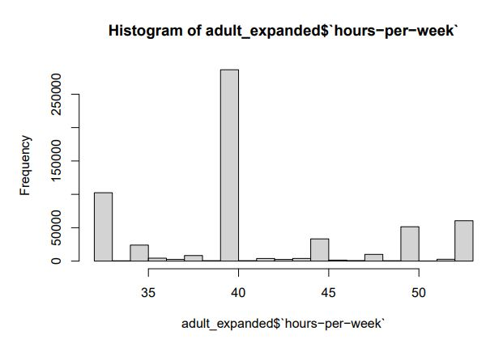
Diagrams for Numeric Variables: Hour Per Week

Slide 22
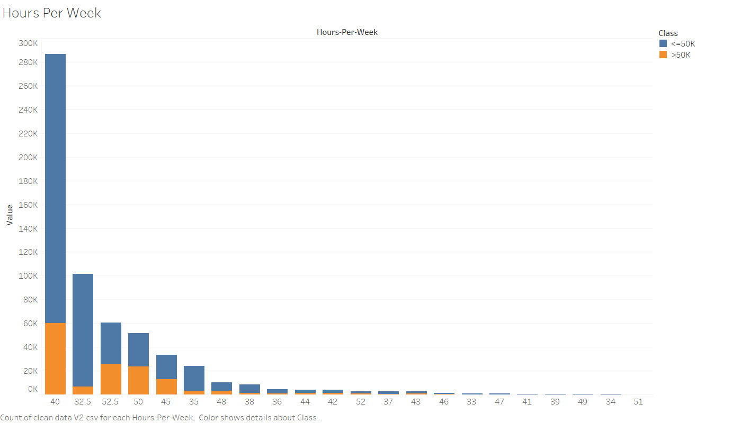
Diagrams for Numeric Variables - Hours Per Week- (1/2)

Slide 23
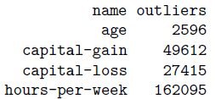
Outliers and missing values
We found outliers in each of numerical variables, which are shown below
We will not deal with the outliers in “Capital-gain” and “Capital-loss” as the majority data in these two variables are zero and the reason is probably these people did not do any investment. Then we believe it is not very necessary to consider these two numeric variables.
The way that we deal with outliers in “Age” and “Hours-per-week” is setting any higher outliers (> Q3+1.5*IQR) to Q3+1.5IQR and setting any lower outliers (< Q1-1.5*IQR) to Q1-1.5*IQR, rather than replacing all the outliers with the mean or median. To achieve this, we will not set these outliers to missing values here because we need to values to do comparison with IQR.

Slide 24
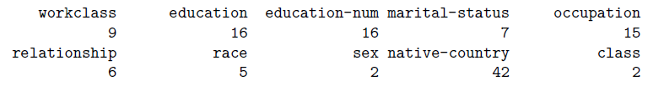
Categorical variables analysis
We count the unique values of each categorical variables, including the missing values.
There are missing values in variables “workclass”, “occupation”, and “native-country”.
And we also checked the factors in each variables to see if there is any unusual values existing. Fortunately, there are no unusual values in any of the categorical variables.

Slide 25
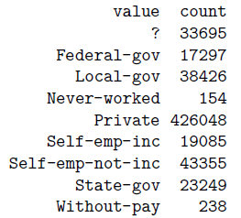
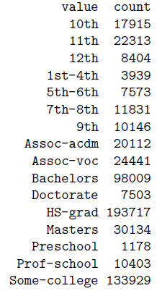
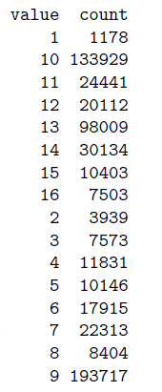
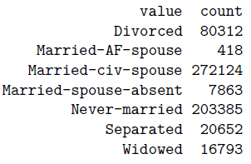
Unusual value check (⅓)
Education
Education-num
Workclass
Marital-status

Slide 26
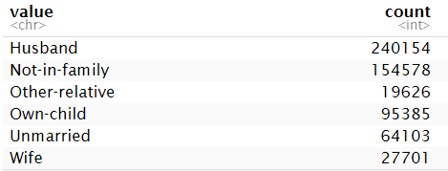
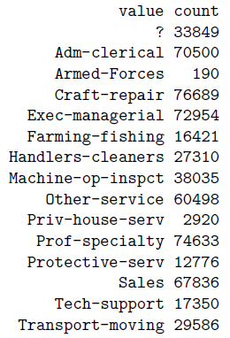
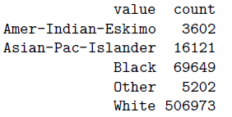
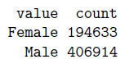
Unusual value check (⅔)
Relationship
Occupation
Race
Sex

Slide 27
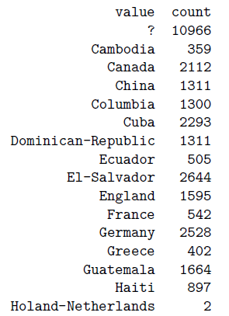
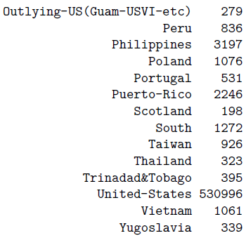
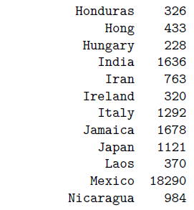
Unusual value check (3/3)
Native Country

Slide 28
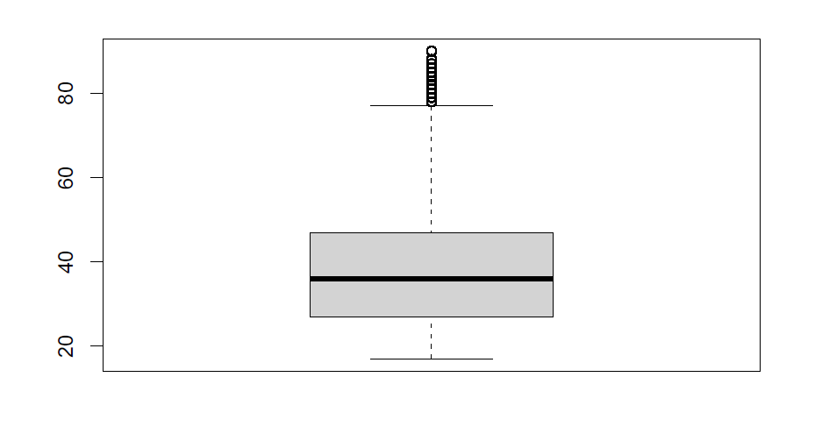
Missing value imputation - Age
Before

Slide 29
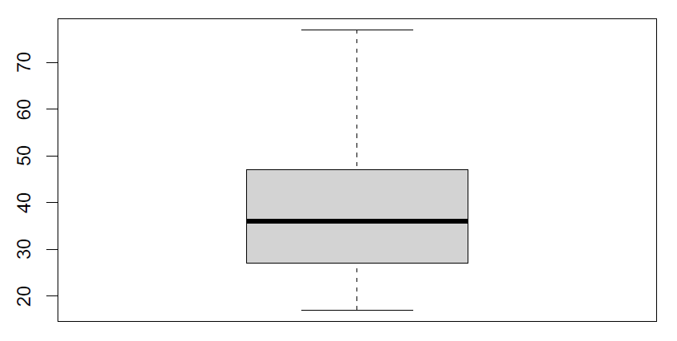
Missing value imputation - Age
After

Slide 30
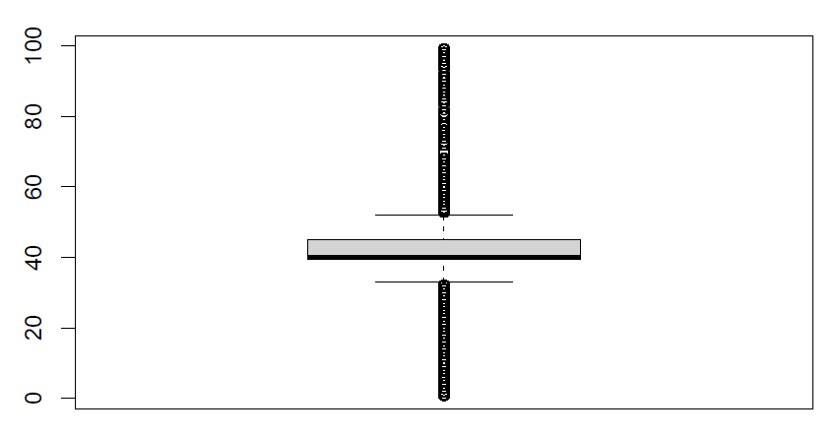
Missing value imputation - Hours per week
Before

Slide 31
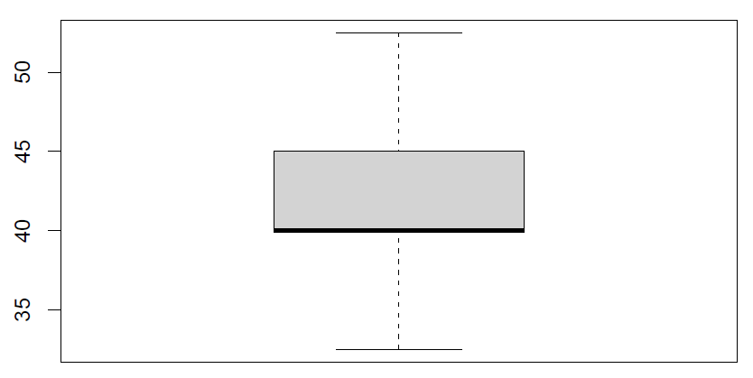
Missing value imputation - Hours per week
After

Slide 32
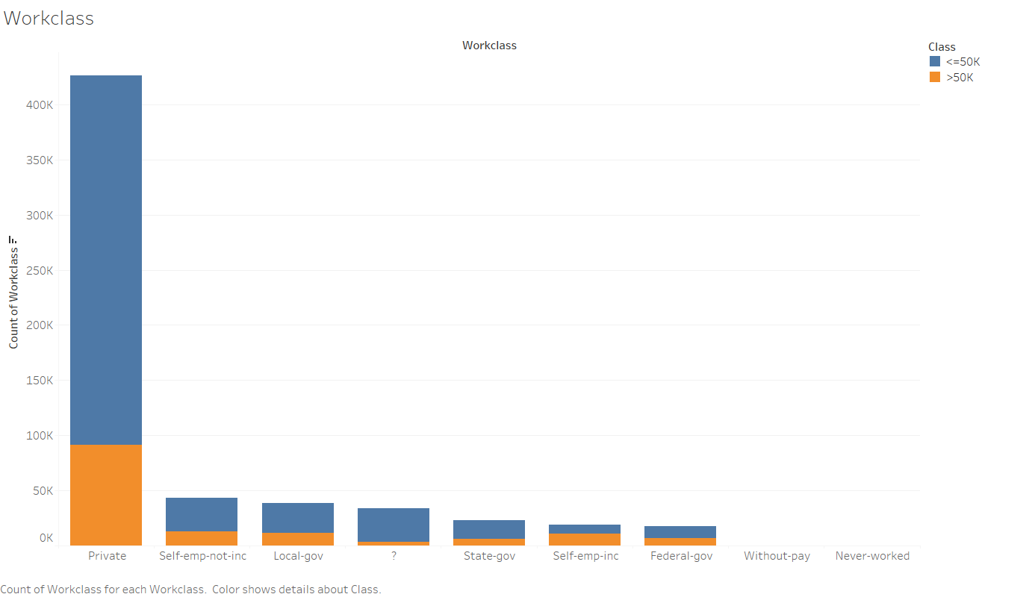
Diagrams for Categorical Variables - Workclass

Slide 33
Diagrams for Categorical Variables - Education

Slide 34
Diagrams for Categorical Variables - Marital Status

Slide 35
Diagrams for Categorical Variables - Occupation

Slide 36
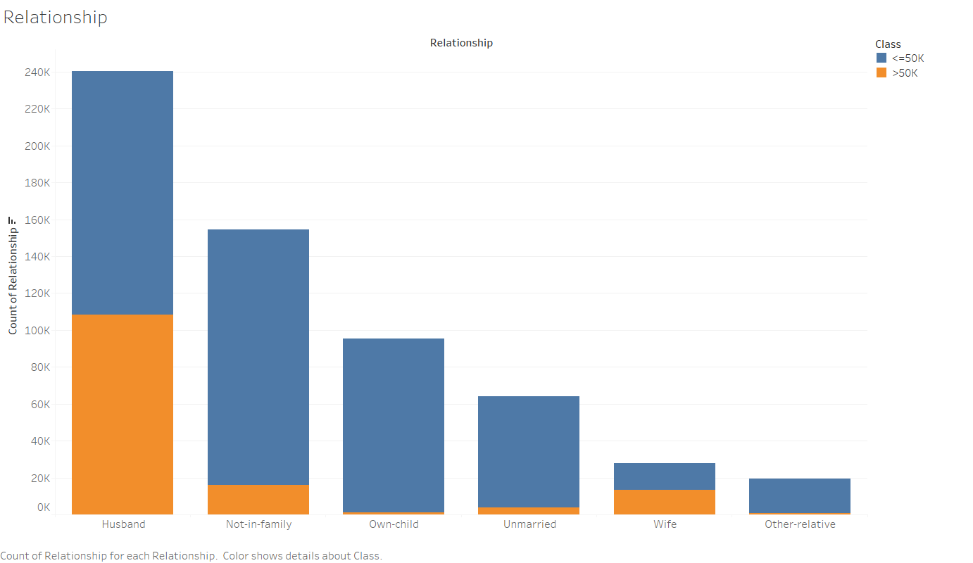
Diagrams for Categorical Variables - Relationships

Slide 37
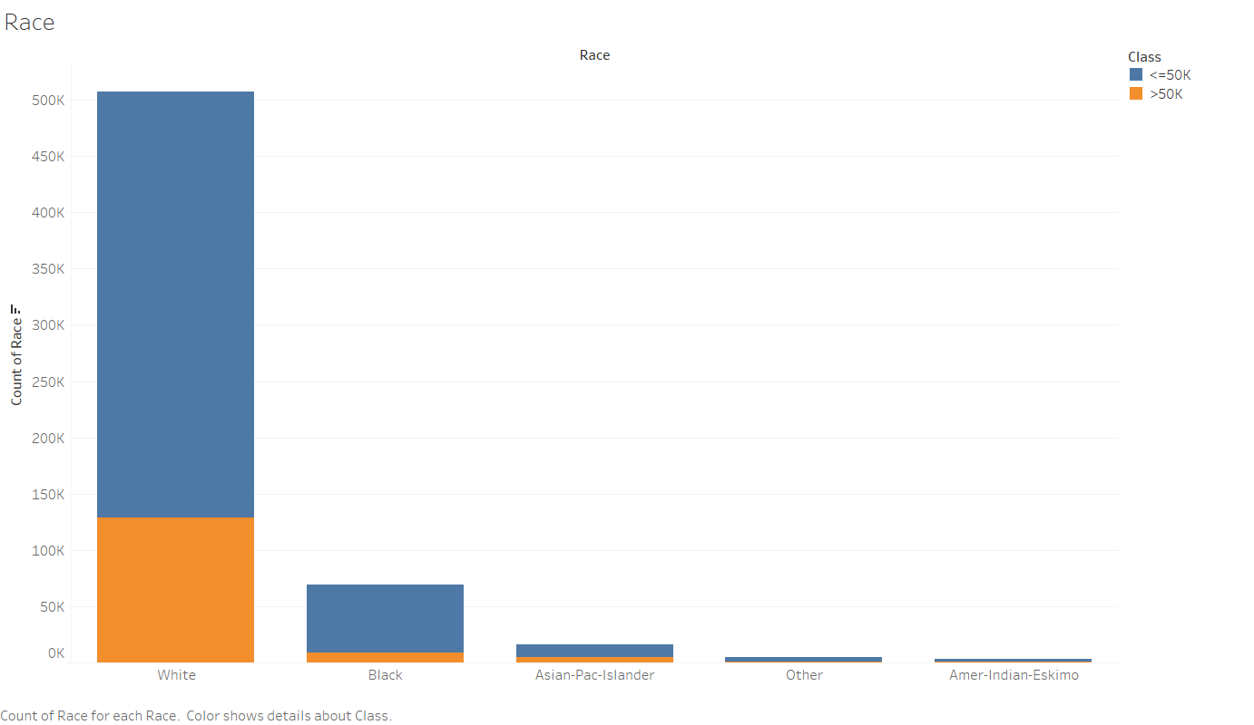
Diagrams for Categorical Variables - Race

Slide 38
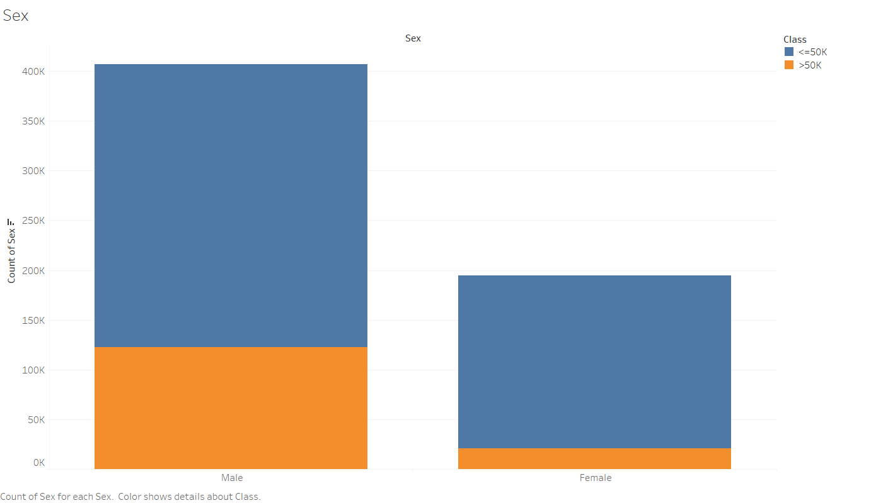
Diagrams for Categorical Variables - Sex

Slide 39
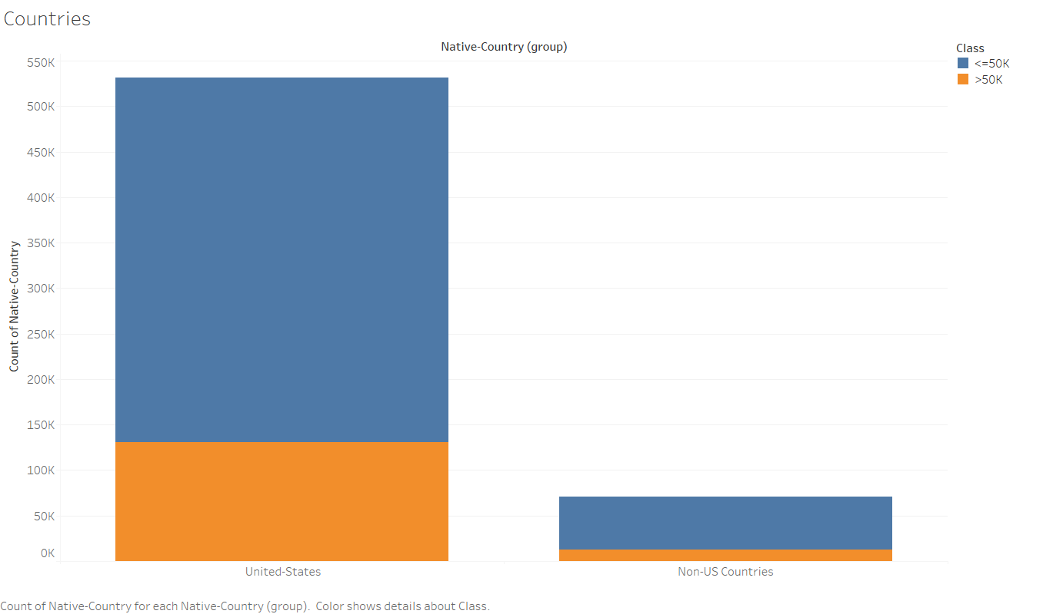
Diagrams for Categorical Variables - Native Countries

Slide 40
Diagrams for Numeric Variables - Hours Per Week- (2/2)

Slide 41
Age vs Income

Slide 42
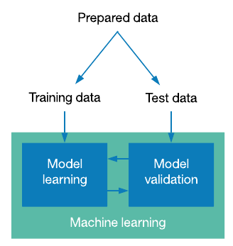
Overview of our Modelling Approach

Slide 43
Classification Models Used
Naive Bayes Classifier
Logistic Regression Classifier
Decision tree Classifier
Random Forest Classifier

Slide 44
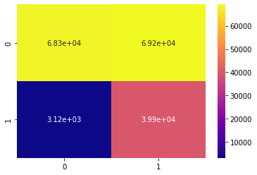
Naive Bayes Model: Confusion Matrix

Slide 45
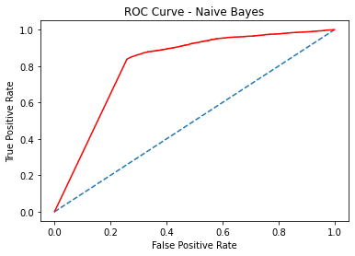
Naive Bayes Model: ROC Curve
AUC Score of Naive Bayes Model is 0.808
Notes:
!Add auc score!

Slide 46
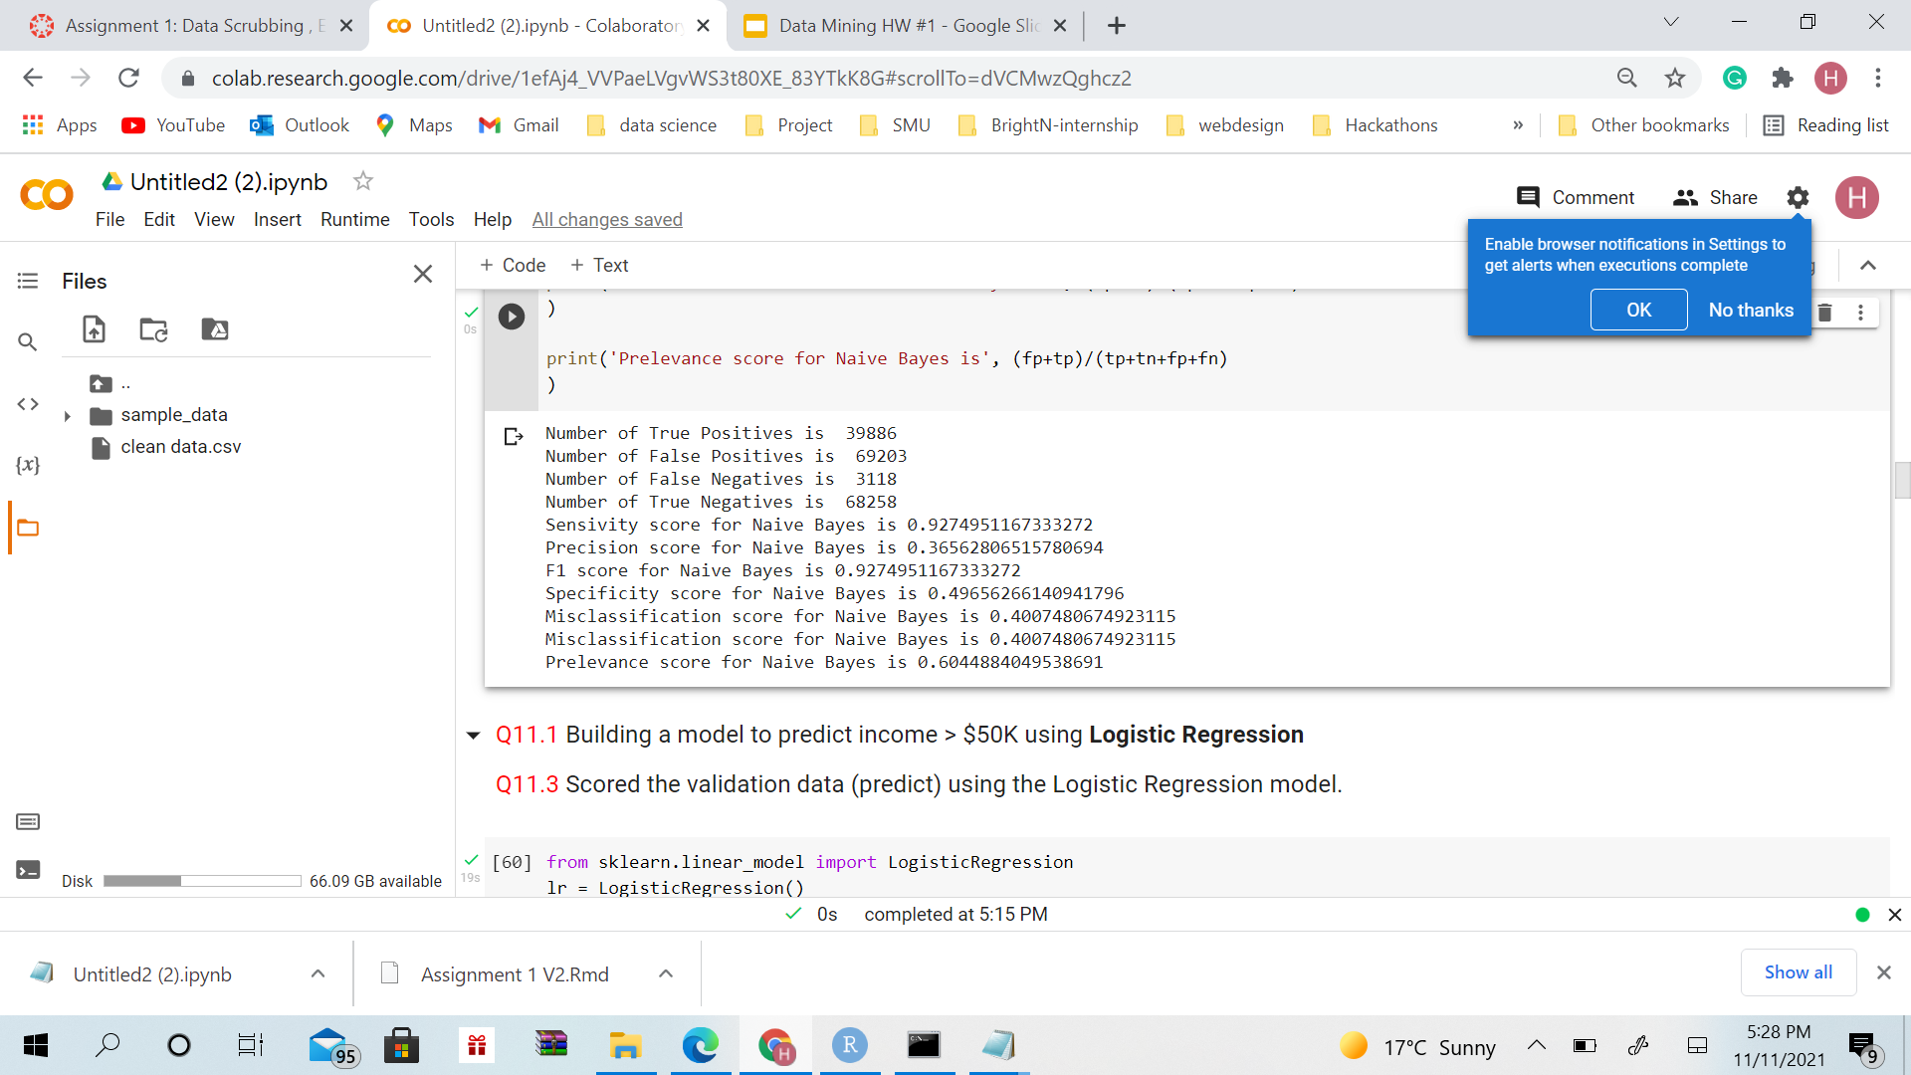
Naive Bayes Model: Other Performance Metrics

Slide 47
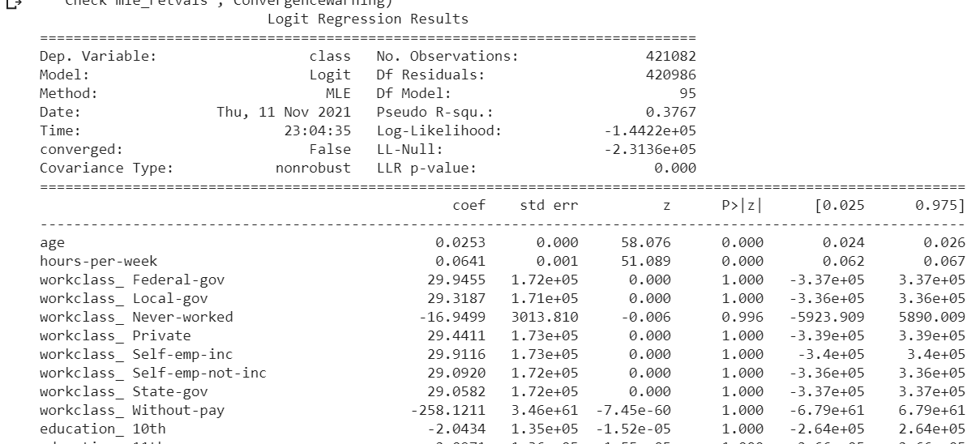
Logistic Regression Model
From the above logistic regression results, we can infer that age and hours-per-week variables can be considered to reject the null hypothesis as p-values of these variables are less than 0.05. This means that these variables are relevant in making a prediction

Slide 48
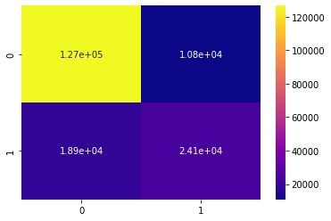
Logistic Regression Model: Confusion Matrix

Slide 49
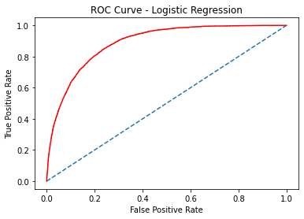
Logistic Regression Model: ROC Curve
AUC Score of Logistic Regression Model is 0.887

Slide 50
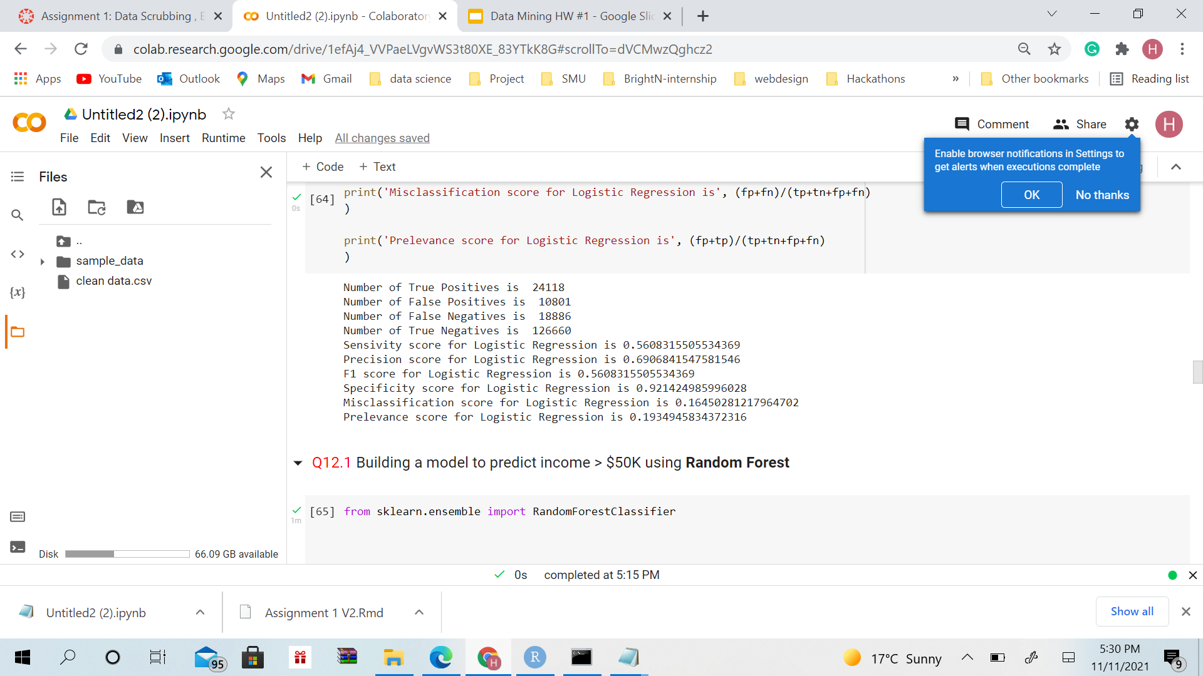
Logistic Regression Model: Other Performance Metrics

Slide 51
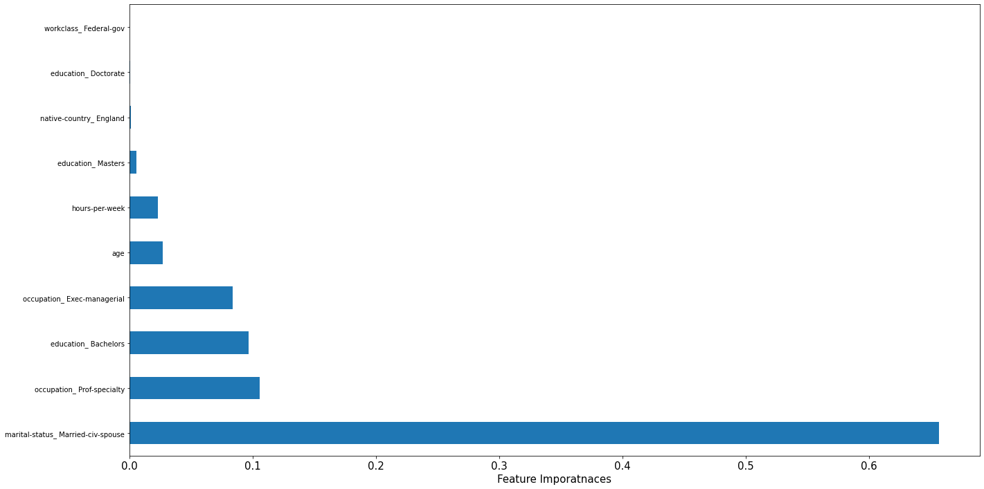
Decision Tree Model
From the above graph, we have decided that variables like Exec management and Prof services, Marital status civ spouse,education:bachelors, education:,, hours per week can be used for making decision rules

Slide 52

Decision Tree Model: Confusion Matrix

Slide 53

Decision Tree Model: ROC Curve
AUC Score of Decision Tree Model is 0.845

Slide 54
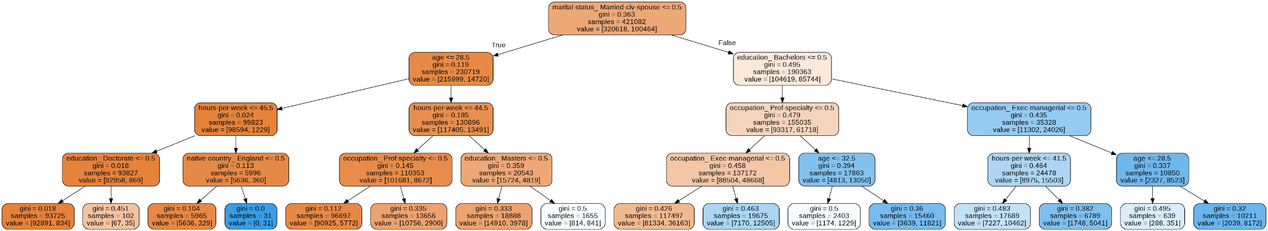
Decision Tree Model: Tree Plot

Slide 55
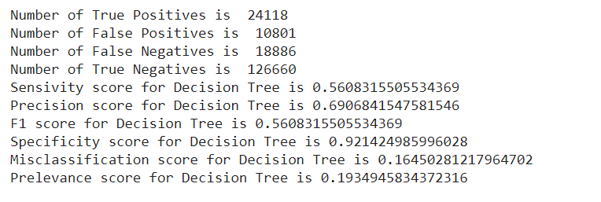
Decision Tree Model: Other Performance Metrics

Slide 56
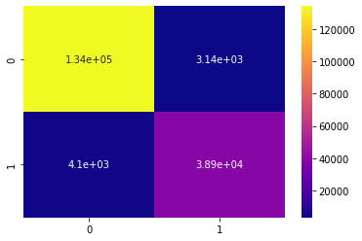
Random Forest Model: Confusion Matrix

Slide 57

Random Forest Model: ROC Curve
The AUC Score for Random Forest Model is 0.994

Slide 58

Random Forest Model: Other Performance Metrics

Slide 59

Comparison of all Models: Accuracy score

Slide 60

Comparison of all Models: ROC plot

Slide 61
Overall Comparison of all Models
Models | Accuracy | Specificity | Sensitivity | Precision | F-Score | Error Rate | AUC Score
Naive Bayes | 0.60 | 0.93 | 0.92 | 0.96 | 0.65 | 0.40 | 0.808
Logistic Regression | 0.84 | 0.56 | 0.56 | 0.69 | 0.62 | 0.164 | 0.887
Decision Tree | 0.82 | 0.50 | 0.56 | 0.67 | 0.57 | 0.164 | 0.994
Random Forest | 0.96 | 0.90 | 0.56 | 0.92 | 0.91 | 0.165 | 0.994

